Slide 1

Implementing and reusing shareable statistical services: Lessons learned
Lisbon, 27 and 28 April 2021
I3S ESSnet final workshop
Francesco Amato, Mauro Bruno, Giuseppina Ruocco, Manuel Soulier, Romain Tailhurat
Istat | DIRECTORATE FOR METHODOLOGY AND STATISTICAL PROCESS DESIGN

Slide 2
Outline
Overview of the insights gained
Service development experience
Service reuse: challenges and lessons learned
Beyond service reuse
Plans for the future
Conclusions

Slide 3
Overview of the insights gained (1)
The development of shareable and reusable statistical services concern several aspects, such as the architectural, methodological and the technological dimensions. The ESSnet experience has highlighted the relevance of the following tasks in implementing shareable statistical service, either from scratch or from existing components:
Identify and separate the core logic from the additional features (CSPA model)
Analyse the statistical service in relation to the statistical process pipeline to identify the dependencies with other statistical services
Define the minimum set of metadata to describe statistical service methods, input and outputs

Slide 4
Overview of the insights gained (2)
Follow an iterative improvement approach considering the different stakeholders involved and the feedbacks from users and from IT people
Adopt official statistical standards as reference framework to model and implement each step of the service pipeline
Use of Gsim objects helps to model and standardize data structures and process metadata, and fosters the reuse of software solutions between NSIs
Use of tools that enhance a cooperative approach: open source solutions, service deployment (from GitHub to production), service containerization

Slide 5
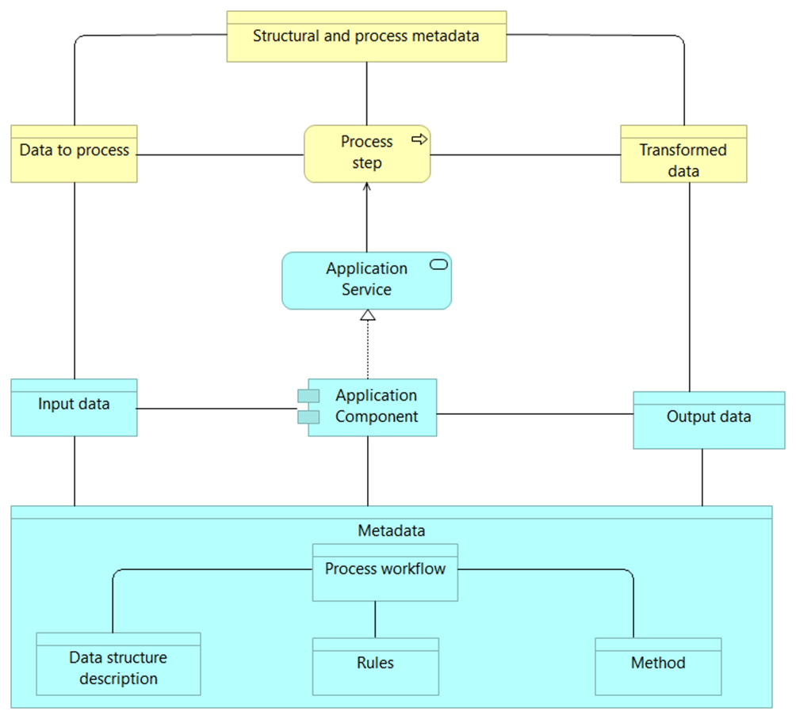
Service development experience
In order to implement shareable statistical services, one of the main steps is to model the business process and the application services used by each process step. This approach helps to:
Build self-contained modules and to relate each application component to specific process steps
Connect the business and the application layers
Reduce overlapping of application components and enhance the reuse of implemented solutions
Standardize data and metadata structures processed by the core logic functionalities, modelling for instance input and output variables, parameters and algorithms
Core logic of a statistical service

Slide 6
Service reuse: challenges and lessons learned (1)
Main challenges related to the reuse of a statistical service:
Coping with legacy architecture and IT infrastructure, particularly assessing how the statistical service to reuse fits in the process chain
Dealing with services dependencies and specific issues due to some characteristics of the reuse context
Service version management (bug fixing, code enhancement, issues on github)
User support: a user may have some challenges or doubts during the reuse. The issues that may arise differ according to the users’ background and skills, and may concern the methodology, data or IT management

Slide 7
Service reuse: challenges and lessons learned (2)
Main lessons learnt during the reuse activities :
The adoption of common architectural patterns and statistical standards for service implementation also facilitates the service reuse;
The setup of the service in the reuse organization may require methodological and technical support, or the development of missing functionalities;
Subject-matter experts and methodologists should cooperate to the selection and management of the reuse business case. According to the ESSnet experience, service reuse concerns several aspects, such as strategy and organization, not only IT developments.

Slide 8
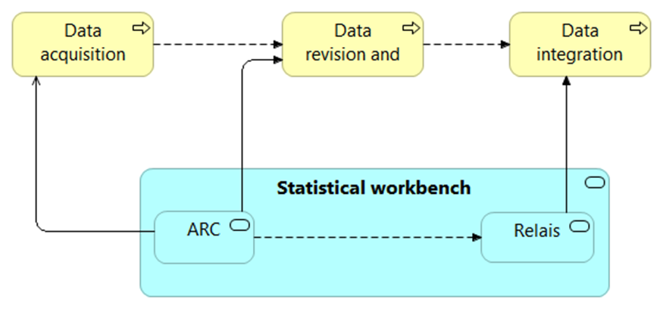
Beyond service reuse
Another ambitious goal, set at the beginning of the project, was the integration between ARC and RELAIS in a statistical workbench
The integrated service should allow acquiring input data, validating them according to a predetermined set of rules, and linking them with other sources to enrich the collected information.
The development of the integrated service concerns several aspects, such as data access, definition and management of process parameters, modelling input and output of each step
Before starting any coding activity, these aspects should be analyzed in detail, by modelling a target architecture that describes the steps to execute and the related information objects, as well as the application layer
ARC & Relais integration

Slide 9
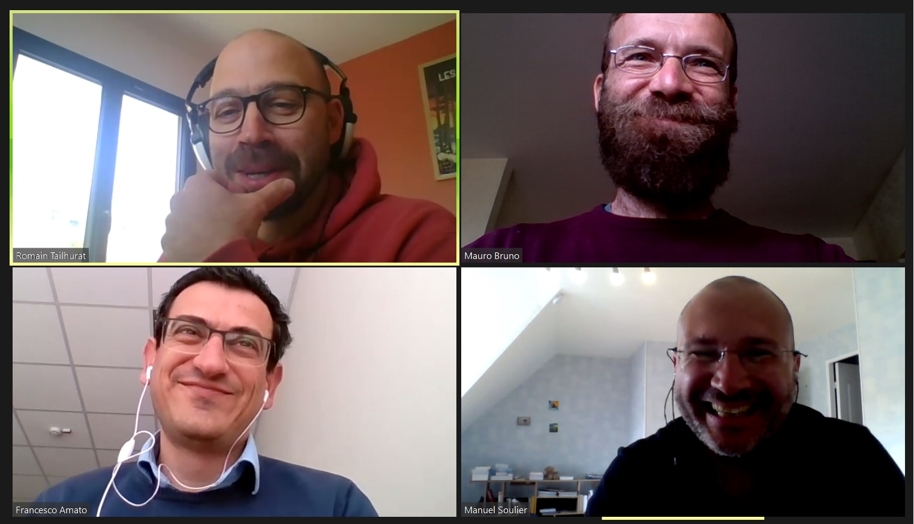
Plans for the future (1)
The results achieved in the ESSnet are so promising, that Istat and Insee decided to continue working together on the core topics of the project:
Statistical services integration, improving the current version of IS2 Workbench
Cloud architectures (docker, Kubernetes, Spark, etc.)
Methods for Big Data sources processing
…
Happy people talking about service integration…

Slide 10
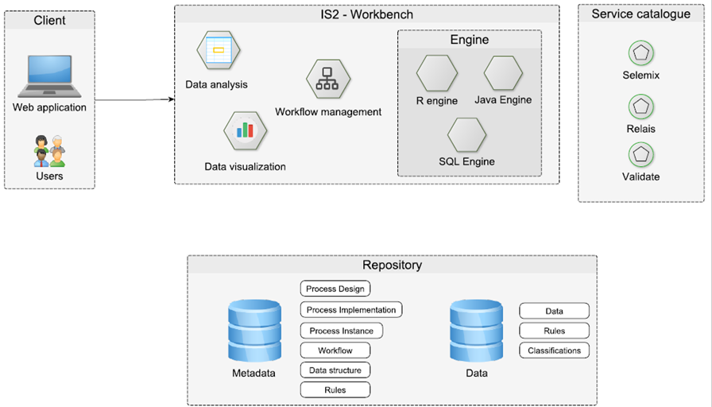
Plans for the future (2)
Within this context, IS² Workbench will be re-designed to improve the current architecture and add new features for accessing and processing new data sources
Sketch of IS² current architecture (strongly coupled)

Slide 11
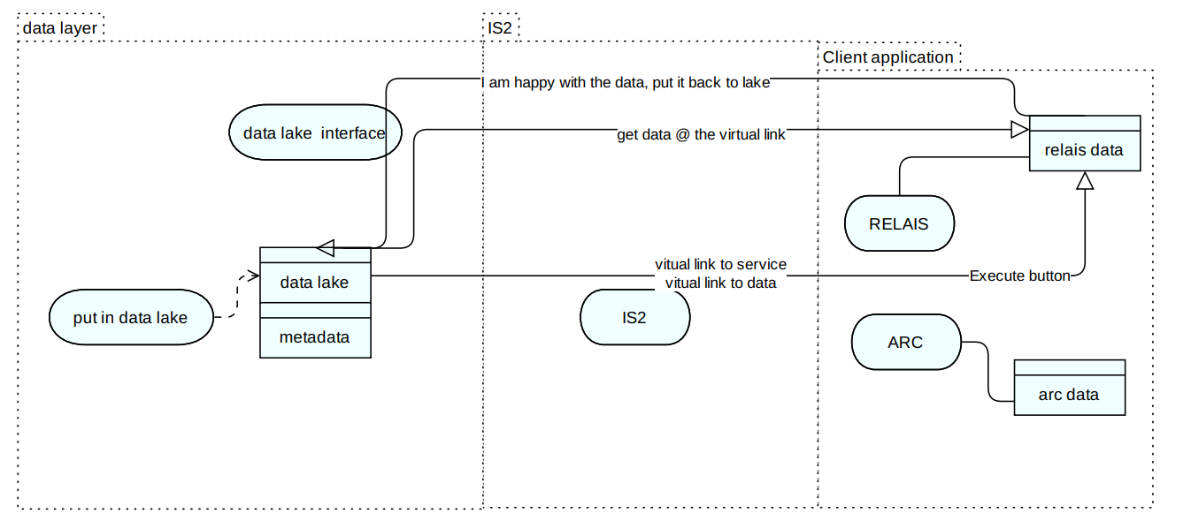
Plans for the future (2)
Within this context, IS² Workbench will be re-designed to improve the current architecture and add new features for accessing and processing new data sources
Sketch of IS² future architecture (loosely coupled)

Slide 12
Conclusions
The ESSnet experience has confirmed the relevance of official statistical standards in the development and reuse of shareable statistical services:
CSPA principles have guided the implementation activities, highlighting the service features to enhance during the refactoring of existing components
GSIM concepts have enabled the standardization of input and output data to process during the service execution.
The analysis of service dependencies should be carried from an architectural perspective considering the deployment environment and the statistical process chain also. This approach enables to identify and meet the specific requirements of different use cases, inside as well as outside the developer organization.
A closer cooperation between NSIs, as well as between IT experts and subject matter people is essential to create skills and develop capabilities that foster service shareability and reuse by design.

Slide 13
Thank you

